Slide 1

Industry Oriented Mini Project
Speed And Pothole Detection Enhancing Road Safety
Project batch No:- A-6
Batch Members:-
K.Sai Divya Sree (21271A0538)
D.Likhitha (21275A0516)
B.Avanthika (21271A0509)
V.Premsai (22275A0501)
Under The Supervision of: Dr.M.Ravinder
Associate Professor
JITS , Karimnagar

Slide 2
Agenda
Abstract
Introduction
Literature Survey
Problem Statement
Existing and Proposed system
System Requirements
System Design
Coding and Testing
Result Analysis
Conclusion

Slide 3
Abstract
In recent years, road safety and vehicle maintenance have become critical concerns. One major factor contributing to vehicle damage and accidents is the presence of potholes. Additionally, monitoring vehicle speed is essential for ensuring safety on the roads. The system employs ultrasonic sensors mounted on vehicles to measure the distance to the road surface, enabling the detection of potholes. Simultaneously, vehicle speed is monitored by calculating the time intervals between sensor readings. When a pothole is detected or if the vehicle exceeds a predefined speed limit, visual and auditory alerts are triggered through IR sensor and buzzer. This approach ensures immediate feedback to the driver, enhancing safety and promoting cautious driving behavior.

Slide 4
Introduction
As population grows, maintaining safe and efficient roadways has become increasingly challenging.
Potholes and speeding are two significant issues that compromise road safety, leading to accidents and vehicle damage.

Slide 5
Introduction
Traditional methods for monitoring road conditions often rely on centralized systems, which can be expensive and require extensive infrastructure.
To drivers, leaving them unaware of potential hazards until Additionally, these systems may not provide real-time feedback it is too late.

Slide 6
Introduction
This project presents a low-cost loT-based system that detects potholes and monitors vehicle speed .
When a pothole is detected , the system activates visual alerts through audible warnings via buzzers, providing immediate feedback to the driver.
This approach enhances safety.

Slide 7
Literature Survey:-
1. An Advanced IoT-Based System for Real-Time Pothole Detection, Tracking, and Maintenance
Authors : Mr.Sahel Bej, Swarnava Roy, Satyabrata Maity
Published in Year :2023
This paper proposed a IOT system which offers a promising solution to address the growing issue of road maintenance and safety.By integrating deep learning-based object detection with ultrasonic sensors, the system effectively detects and tracks potholes, contributing to improved road condition monitoring.Further studies on real-world implementation in different environments will be crucial to assess the system's scalability and potential for widespread adoption.

Slide 8
Literature Survey
2. Sensor-based espial of potholes and humps on roads with instant notification alert using IoT
Authors :Mr G.Prakash , Raadha S, Tanu Swami
Published in Year :2022
In this paper the author proposed that Manual detection of potholes in roads can be time-consuming, inaccurate and in efficient.In this system the components used is Ultrasonic sensor .further enhanced to detect different types of potholes under various conditions, such as day and night.

Slide 9
Literature Survey:-
3. Survey on IOT Based Pothole Detection
Authors :Mrs R Anandhi ,Swathi Baswaraju,Silpa
Published in Year :2022
The author has discussed that Potholes can cause damage like flat tires and wheels damage, vehicle collisions, and severe accidents.When there's a pothole approaching, it gets scans by using Infrared and Ultrasonic sensor, alerting the driver on time. This method becomes useful during the rainy season where the roads are crammed with rainwater.Further enhancement should be taken regarding notification which help drivers make more informed choices. Reduce misclassifications.

Slide 10

S.NO | Title | Authors | Year
1 | An Advanced IoT-Based System for Real-Time Pothole Detection, Tracking, and Maintenance | Mr.Sahel Bej, Swarnava Roy, Satyabrata Maity | 2023
2 | Sensor-based espial of potholes and humps on roads with instant notification alert using IoT | Mr G.Prakash , Raadha S, Tanu Swami | 2022
3 | Survey on IOT Based Pothole Detection | Mrs R Anandhi ,Swathi Baswaraju,Silpa | 2022

Slide 11
Problem Statement
Potholes and overspeeding increase the risk of accidents and vehicle damage.There is a need for a simple, real-time system that can detect potholes and monitor speed and by providing immediate alerts to drivers.

Slide 12
Existing System
Current pothole detection and vehicle speed monitoring systems often utilize GPS technology and cloud platforms to gather and analyze data.
While these systems can be effective, they are limited by their reliance on connectivity, can incur high costs, and may not provide immediate feedback to drivers.
Additionally, these solutions may not be practical in rural or poorly connected areas, where maintenance of road safety is critical.

Slide 13
Proposed system
The proposed loT-based system aims to address the limitations of existing solutions by implementing a combination of ultrasonic and IR sensors.
The ultrasonic sensor detects potholes by measuring changes in distance to the road surface, while the IR sensor monitors the vehicle's speed by sensing its movement over a defined distance.
The system alerts drivers through visual and auditory (buzzer) signals, providing real-time feedback without needing GPS or cloud connectivity.
This design is not only cost-effective but also easy to deploy in various environments, enhancing road safety and reducing the risk of accidents.

Slide 14
System Requirements
Hardware Requirements :
Ultrasonic Sensor(HC-SR04 )
IR Sensor
Microcontroller Arduino UNO
Buzzer
Software Requirements :
Arduino IDE

Slide 15
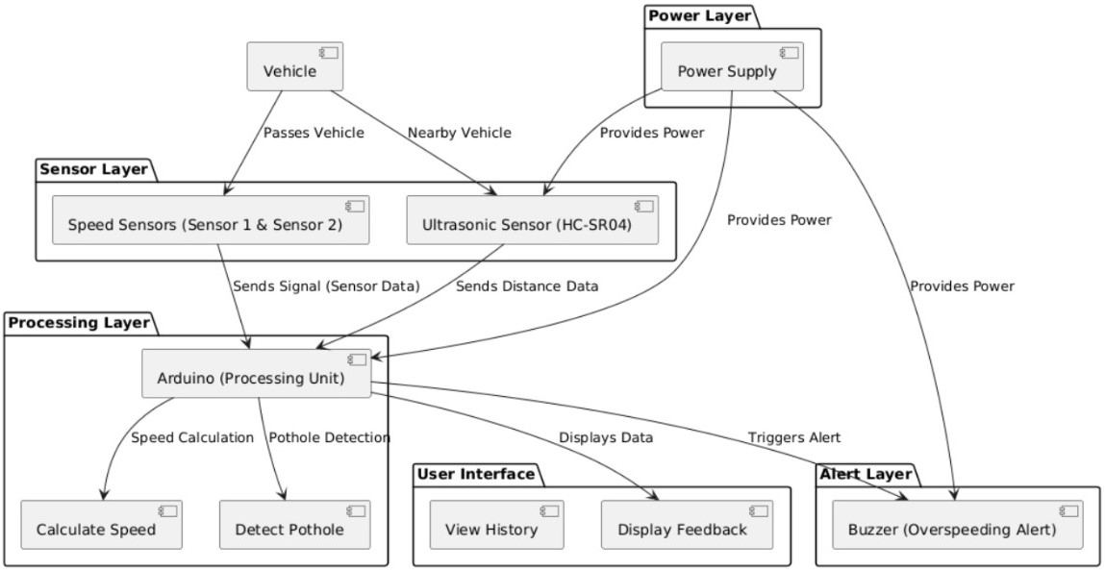
System Design
System Architecture

Slide 16
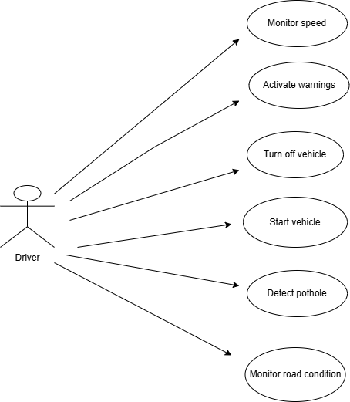
UML Diagrams
Use Case :

Slide 17
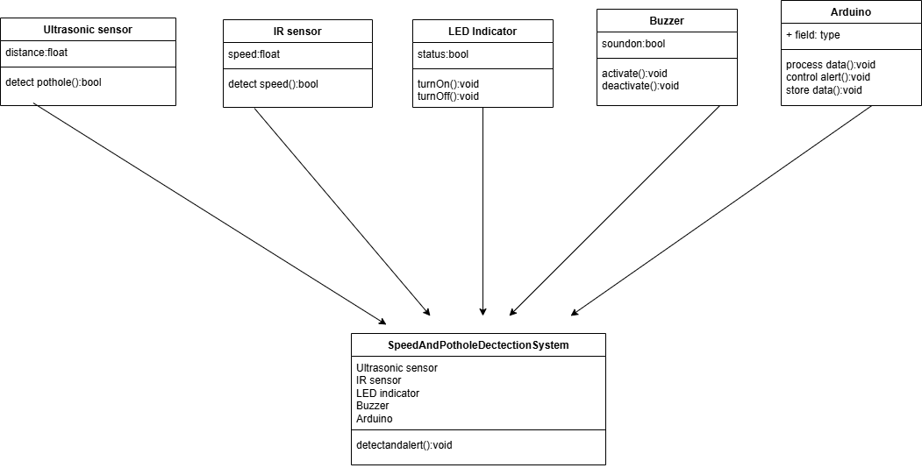
UML Diagrams
Class Diagram :

Slide 18
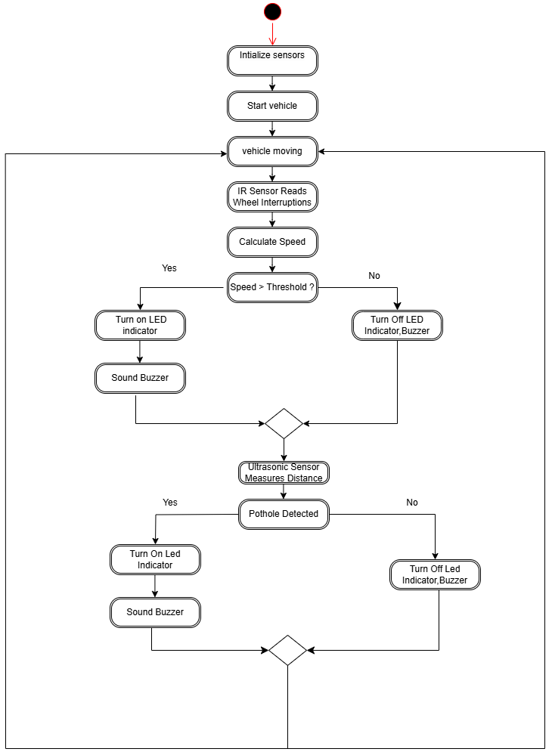
UML Diagrams
Activity Diagram :

Slide 19
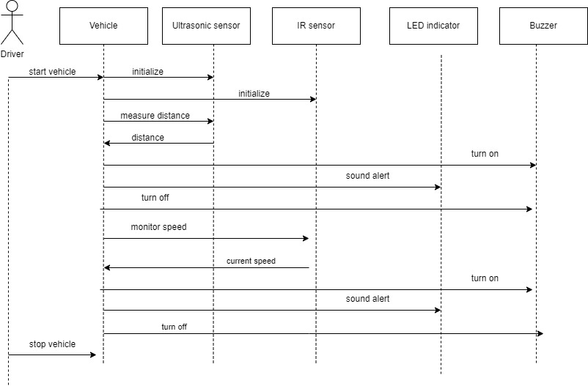
UML Diagrams
Sequence Diagram

Slide 20
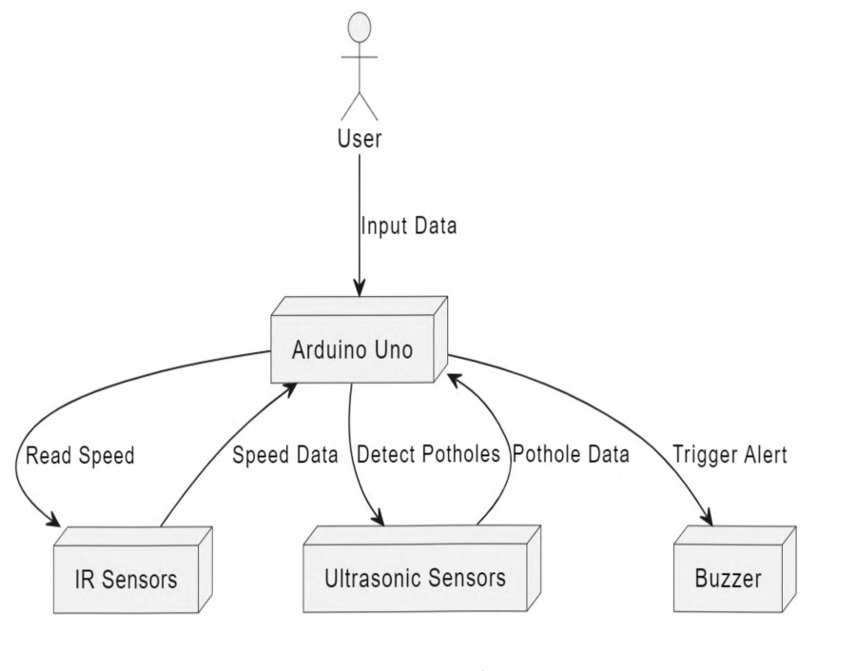
Data Flow Diagram

Slide 21
Coding and Testing
Ultrasonic Distance Measurement:
The HC-SR04 ultrasonic sensor is used to measure the distance to the pothole.
The trigPin sends a pulse, and the echoPin receives the returning pulse.
The distance variable calculates the time it takes for the ultrasonic wave to travel to the object and back.
Pole Detection:
There are two additional sensors (sensor1 and sensor2) .
These could be used to detect poles or gates, and the code calculates the speed of the vehicle based on the time
difference between detecting these two sensors.
Speed Calculation:
The distance is the known distance between the two sensors, and the time is the difference between when the
vehicle crosses sensor1 and sensor2.
Buzzer for Over-speeding:
If the calculated speed exceeds speed the buzzer is triggered to indicate over-speeding.

Slide 22
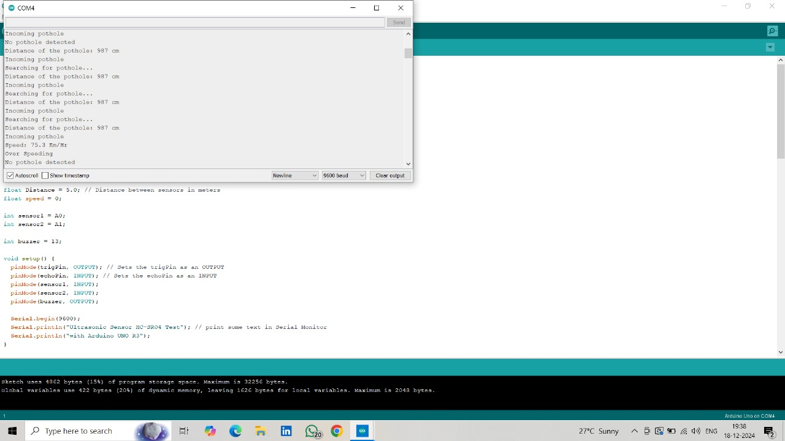
may cause detection issues).
are
RESULT ANALYSIS

Slide 23
Conclusion
This project presents an innovative approach by leveraging ultrasonic and IR sensors, the system effectively detects potholes and monitors vehicle speed in real-time, providing immediate alerts to drivers.
It signficantly enhance driver awareness and safety on the roads.
It provides easy accessibility for use in diverse environments, including rural areas with limited connectivity.

Slide 24
THANK YOU !

